Slide 1
Student Details
Name : Vyakaranam Sowmya
SkillBuild ID : vyakaranamsowmya8@gmail.com
College Name : Vignan Institute of Information Technology
Internship Domain and Internship start and End Date : Artificial Intelligence /

Slide 2
Sentiment Analysis of Restaurant Reviews
Analysing restaurant data for customer satisfaction allows customer insights to be unlocked. The use of machine learning techniques enables these evaluations to be grouped into positive, negative, and neutral emotions, thus facilitating data-driven decision-making.
The use of emotional analytics can feed the overall experience has been enhanced by improving food quality, service, and atmosphere. This process not only delivers informed decisions but also ensures customer-centric improvements, and provides actionable feedback that supports guests and restaurant management
This insight allows restaurants to access it improvements and adjustments are made to meet customer expectations, ultimately a more satisfying dining experience for all Helps show customer sentiment but also provides valuable feedback on specific areas of interest Improvement of the restaurant, allowing for targeted development and resource allocation.

Slide 3
AGENDA
Project Overview
Who are end Users
Solution and its valuble proposition
project Customization
Modelling
Results
Links

Slide 4
PROJECT OVERVIEW
Objective:
The main objective of this project is to analyse customer perceptions and measure customer emotions (positive or negative) associated with the restaurant experience.
Methodology:
This project uses advanced natural language processing (NLP) techniques and machine learning models to classify consumer sentiment in a survey.
Benefits:
1. Increased customer satisfaction: By carefully analyzing sentiment, the project aims to identify specific areas where restaurants can improve, ultimately resulting in higher levels of customer satisfaction
2. Real-time Feedback: This project provides restaurant owners with the advantage of receiving immediate feedback from customer reviews, enabling them to make swift and informed decisions for enhancing their establishments.

Slide 5
WHO ARE THE END USERS of this project?
1. Investors: Potential investors in the restaurant business can use sentiment analysis to evaluate the reputation and performance of various establishments, aiding them in making informed investment decisions.
2. Data Analysts: Skilled in data analysis, this job provides a wealth of information on sentiment dynamics and detailed reporting. These analysts can dig deeper into the data, identifying nuggets of insight that can be valuable to the restaurant industry as a whole.
3. Customers: Patrons who want informed dining options can also benefit from this service. They can get a summary of emotions from previous restaurants, helping them choose a restaurant that meets their tastes and expectations.
4. Food analysts: Food analysts can increase the depth of their analysis by incorporating sensory data into their analysis. This new information enables them to provide a detailed and insightful assessment of the restaurant’s supply chain and environment.
5. Restaurant Managers & Restaurant owners: The real-time feedback analysis portion of the project is particularly useful for restaurant managers. It helps them quickly analyse customer sentiment, make decisions on the spot and provide instant feedback to enhance the dining experience

Slide 6
YOUR SOLUTION AND ITS VALUE PROPOSITION
Solution:
Our sentiment analysis for restaurant reviews leverages advanced natural language processing (NLP) techniques and machine learning models to automatically classify customer sentiments in restaurant reviews.
Value Proposition:
Heightened Customer Satisfaction : In the end, our solution makes customers happier and dining experiences better.
Efficient Insights : Swiftly recognize positive, negative, and neutral sentiments in reviews.
Enhanced Customer Experience. : Empower restaurants with data-driven insights to elevate their service quality.
Real-time Feedback : Provide instantaneous feedback to fine-tune restaurant operations on the fly.
Competitive Advantage : Gain a competitive edge by comprehending customer sentiments more deeply.
Informed Decision-making : Enable stakeholders to make well-informed choices that drive business growth.

Slide 7
How did you customize the project and make it your own
While the core sentiment analysis project may not have undergone significant changes, the implementation of a Flask web application adds a layer of interactivity and usability.
By adding a Flask web application, the project becomes more interactive, user-centric, and accessible, ultimately enhancing its utility and user engagement.
Deployment of this Flask app using Heroku or AWS will be very helpful for easier access.

Slide 8
MODELLING
1. Data Preprocessing
2. Feature Extraction
3. Model Selection
4. Training and Validation
5. Hyperparameter Tuning
6. Model Evaluation
7. Deployment
8. Monitoring and Maintenance

Slide 9
Results
Sentiment Analysis: 70% accuracy.
Web Platform: Implemented for user-friendly access.
Key Insights: Majority of reviews are positive.
User Feedback: Positive and aligns with sentiment analysis.
Future Plans: Enhance accuracy and expand web platform features.

Slide 10
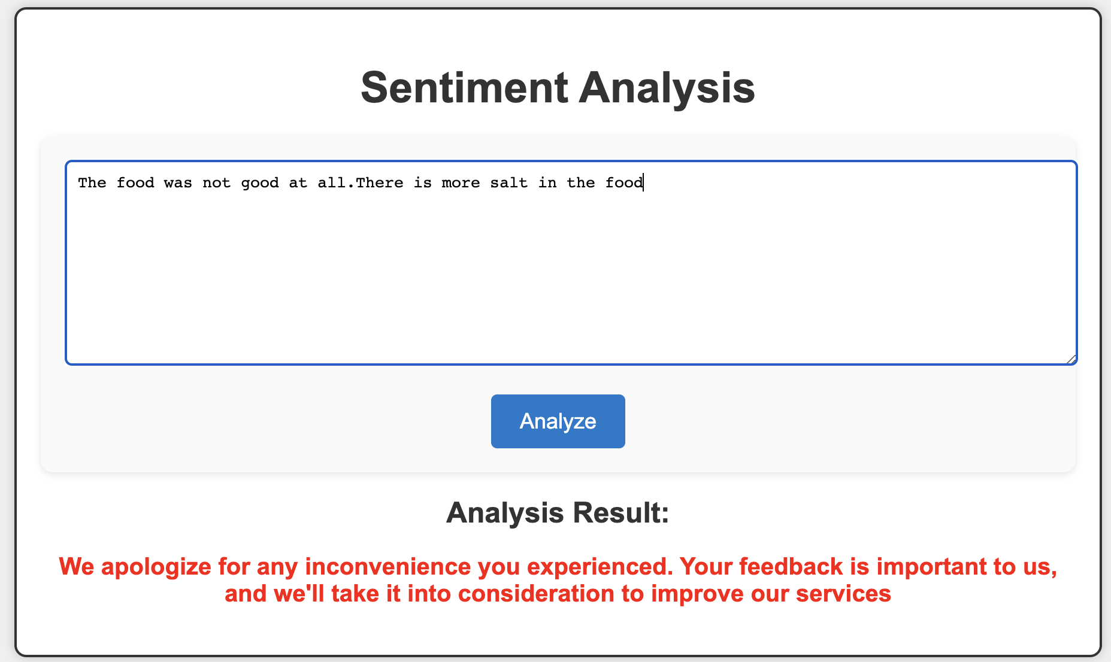
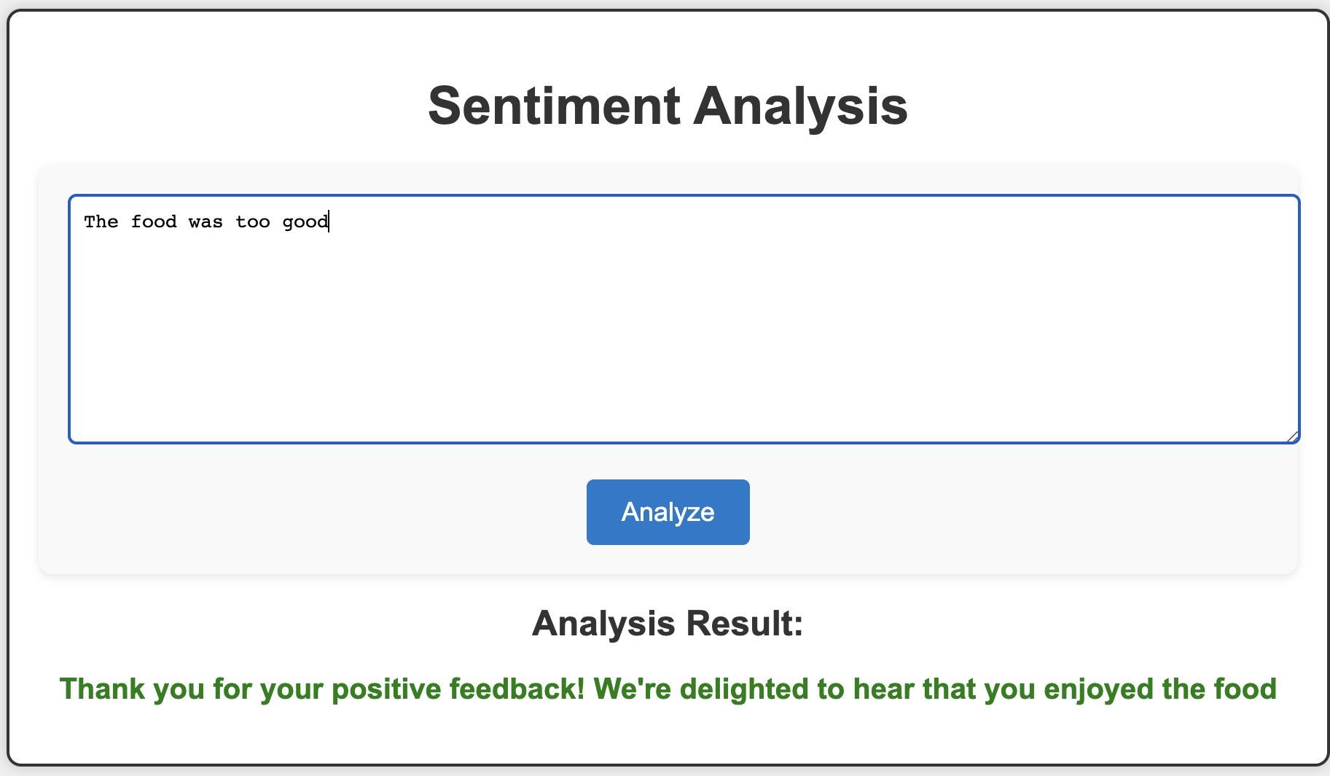
Output photos

Slide 11
links
https://github.com/sowmyavyk/Feedback_Sentiment_Analysis

